Slide 1
X- ray radiation
■ Basic radiation safety rules for diagnostic
radiography:
1-Remove personal from the examination area who are not
involved
2-Never permit anyone under the age 18 in the examination area
during procedure

Slide 2
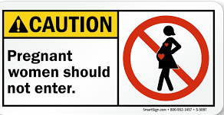
X- ray radiation
3-Never permit pregnant women in the examination
area during the procedure

Slide 3
X- ray radiation
4-Rotate personal who assist with the radiographic
examination
5-Never permit any part of the body to be within
the primary beam
6-Use patient tranquilization whenever possible

Slide 4
X- ray radiation
7-Always wear lead aprons when assisting in the examination
8-Always wear lead gloves when holding a cassette

Slide 5
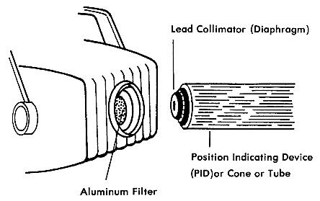
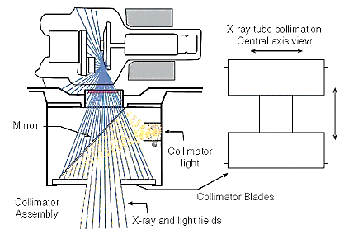
X- ray radiation
9-Use beam collimation to limit the size of the primary
beam.

